Slide 1
Programming Fundamentals
Java Programming Language
Chapter 2

Slide 2
Java - Basic Operators
Java provides a rich set of operators to manipulate variables. We can divide all the Java operators into the following groups:
Arithmetic Operators
Relational Operators
Bitwise Operators
Logical Operators
Assignment Operators
Miscellaneous Operators

Slide 3
The Arithmetic Operators
Arithmetic operators are used in mathematical expressions in the same way that they are used in algebra.
Assume integer variable A holds 10 and variable B holds 20, then −
Operator | Description | Example
+ (Addition) | Adds values on either side of the operator. | A + B will give 30
- (Subtraction) | Subtracts right-hand operand from left-hand operand. | A - B will give -10
* (Multiplication) | Multiplies values on either side of the operator. | A * B will give 200

Slide 4
The Arithmetic Operators (cont.)
Operator | Description | Example
/ (Division) | Divides left-hand operand by right-hand operand. | B / A will give 2
% (Modulus) | Divides left-hand operand by right-hand operand and returns remainder. | B % A will give 0
++ (Increment) | Increases the value of operand by 1. | B++ gives 21
-- (Decrement) | Decreases the value of operand by 1. | B-- gives 19

Slide 5
The Relational Operators
There are following relational operators supported by Java language.
Operator | Description | Example
== (equal to) | Checks if the values of two operands are equal or not, if yes then condition becomes true. | (A == B) is not true.
!= (not equal to) | Checks if the values of two operands are equal or not, if values are not equal then condition becomes true. | (A != B) is true.
> (greater than) | Checks if the value of left operand is greater than the value of right operand, if yes then condition becomes true. | (A > B) is not true.

Slide 6
The Relational Operators (cont.)
Operator | Description | Example
< (less than) | Checks if the value of left operand is less than the value of right operand, if yes then condition becomes true. | (A < B) is true.
>= (greater than or equal to) | Checks if the value of left operand is greater than or equal to the value of right operand, if yes then condition becomes true. | (A >= B) is not true.
<= (less than or equal to) | Checks if the value of left operand is less than or equal to the value of right operand, if yes then condition becomes true. | (A <= B) is true.

Slide 7
The Logical Operators
Assume Boolean variables A holds true and variable B holds false, then:
Operator | Description | Example
&& (logical and) | Called Logical AND operator. If both the operands are non-zero, then the condition becomes true. | (A && B) is false
|| (logical or) | Called Logical OR Operator. If any of the two operands are non-zero, then the condition becomes true. | (A || B) is true
! (logical not) | Called Logical NOT Operator. Use to reverses the logical state of its operand. If a condition is true then Logical NOT operator will make false. | !(A && B) is true

Slide 8
The Assignment Operators
Following are the assignment operators supported by Java language:
Operator | Description | Example
= | Simple assignment operator. Assigns values from right side operands to left side operand. | C = A + B will assign value of A + B into C
+= | Add AND assignment operator. It adds right operand to the left operand and assign the result to left operand. | C += A is equivalent to C = C + A
-= | Subtract AND assignment operator. It subtracts right operand from the left operand and assign the result to left operand. | C -= A is equivalent to C = C – A

Slide 9
The Assignment Operators (cont.)
Operator | Description | Example
*= | Multiply AND assignment operator. It multiplies right operand with the left operand and assign the result to left operand. | C *= A is equivalent to C = C * A
/= | Divide AND assignment operator. It divides left operand with the right operand and assign the result to left operand. | C /= A is equivalent to C = C / A
%= | Modulus AND assignment operator. It takes modulus using two operands and assign the result to left operand. | C %= A is equivalent to C = C % A

Slide 10
Miscellaneous Operators
Conditional Operator ( ? : )
Conditional operator is also known as the ternary operator. This operator consists of three operands and is used to evaluate Boolean expressions. The goal of the operator is to decide, which value should be assigned to the variable. The operator is written as −

Slide 11
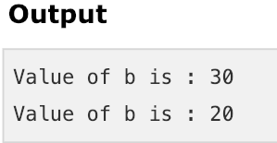
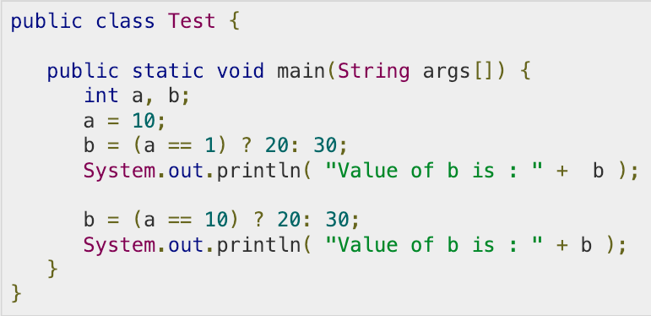
Conditional Operator ( ? : ) (example)

Slide 12
Precedence of Java Operators
Operator precedence determines the grouping of terms in an expression. This affects how an expression is evaluated.
Category | Operator | Associativity
Postfix | expression++ expression-- | Left to right
Unary | ++expression –-expression +expression –expression ! | Right to left
Multiplicative | * / % | Left to right
Additive | + - | Left to right
Equality | == != | Left to right

Slide 13
Precedence of Java Operators (cont.)
Category | Operator | Associativity
Postfix | expression++ expression-- | Left to right
Logical AND | && | Left to right
Logical OR | || | Left to right
Conditional | ?: | Right to left
Assignment | = += -= *= /= %= | Right to left

